Slide 1


Long Term Plan 2023 - 2028
Instruction Memo
July 2022

Slide 2
Summary
1- Guidelines
Strategic guidelines
2- General process
Planning
Distinctive procedure per country
3- Analysis
Presentation & analysis
Synthetic table of analysis
4- Assumptions
Inflation
Financing / taxes / FX rates
Fuel
Managements & brand fees
5- Guidelines
Guidelines for small countries
Guidelines for big countries
6- Appendices
LTP Segmentation
Categories defined by the Strategy Department

Slide 3

1. Strategic Guidelines

Slide 4
Strategic review is to deliver a profitable growth 1/2
Ambition reaffirmed at group level with:
2% net result targeted by 2025
ROCE >7%
Focus on profitable growth
Prioritization of resources allocation
At country level, decision statement of strategic review to be implemented on this Long Term Plan
Decision statement should be strictly applied. A specific slide will have to compare decision statement with effective hypothesis taken in LTP (see slide 11)
Any change should be previously validated with Strategy Department
Contract management actions would have to be highlighted in your presentation
For segments of activities defined as red or orange*, countries will present the underlying action plan for recovery (timeline, specific milestones) and a year on year bridge sustaining profitability turnaround
For segments of activities defined as yellow*, countries will present their growth assumptions and explain the level of development costs, the capital intensity and level of margin retained
Any significant contract considered at risk (ZGP and Growth) will be isolated on a dedicated segment to update LTP if necessary
* See the definition in appendix

Slide 5
Strategic review is to deliver a profitable growth 2/2
Prioritize external growth on specific targets
M&A target will be managed on top for targets already identified in decision statements and based on information provided by country and M&A department
Focus on Net Result
Management fees and HQ costs should be allocated as much as possible per activity for Zero Growth Plan
LTP by activities should include financing costs and tax calculation to give an economic view
Use if necessary the automatic calculation for financing costs and taxes implemented this year in the tool

Slide 6
2. General process

Slide 7
Planning
July 2022
September – December 2022
January – May 2023
July 29th: LTP instruction memo sent to countries
September 9th: LTP segmentation received from countries
September 16th: F2 reported in Vector
September 30th: Openings available with Actual 2021 & F2 2022
October 25th: Budget reported in Vector
November 2nd: Openings available with Actual 2021 & F2 2022 & Budget 2023 (Draft)
November 11th: Deadline for the LTP for small countries in Excel
Financial Projections
November 15th: Openings available with Actual 2021 & F2 2022 & Budget 2023 (Definitive)
November 18th: Deadline for the LTP in Tango
November 23th – November 25th: LTP meetings with countries
December 15th : Presentation to ExCom
January 6th: Presentation to Shareholders
Q1 2023: Update on main significant contracts & Arbitration on M&A

Slide 8
Distinctive procedure per country
Observation: most of LTP volatility from one year to another results from a few countries (category 1 below)
Category 1: Larger countries
Managed by countries
Multi activities
Numerous contracts
Numerous portfolio updates from one year to another
Organic growth
Large volumes of capex
France
USA
Germany
The Netherlands
Sweden
Pacific
Canada
Czech Republic & Slovakia
Transdev Group
Category 2: Smaller or single contract countries
Managed on top
Stable portfolio
No regular tender
LTP can be built on current EBIT projection + capex needed
No capital intensity or capital intensity but with regular capex
Morocco
Spain
Chile
Portugal
United Kingdom
Ireland
Colombia
Asia
New countries
NB: in case of major growth, a category 2 country will flow up on category 1

Slide 9

3. Analysis

Slide 10
Synthetic table of analysis required
A presentation template will be provided at a later stage
We ask you to simplify and limit the size of your presentation as much as possible and focus on key points
Type of analysis | Indicators | Minimum requirements | Template
Assumptions ZGP and organic growth | Major assumptions of the plan Renewals / win / losses Investments: detail of capex (whatever the financing mode) Revenue per contract ZGP & growth Margin expectations and ROCE on new contracts | Revenue per contract >10M€ Organic growth on new activities must be clearly identified on specific segments | See dedicated table in Presentation template
Comparison with 2021 LTP | Revenue EBIT Investments (all financing modes) FCF ROCE post Tax | Last year plan’s financial metrics, on EBIT, ROCE post-tax and Free Cash Flow for the 3 first years of the plan | See executive summary in presentation template
Year on year analysis (changes from one year to another) | Revenue EBIT | Renewals, contracts won & lost, indexation, operations & performance, non recurring should be visible Contract management actions sustaining profitability increase | See dedicated tables in Presentation template
Consistency of key indicators throughout the plan | EBIT Margin (% ROA) Amortization level (% ROA) Net Profit Margin (% ROA) Implicit Interest rate Free Cash Flow (FCF) level & FCF > 0 ROCE post tax | Any major impact should be explained

Slide 11
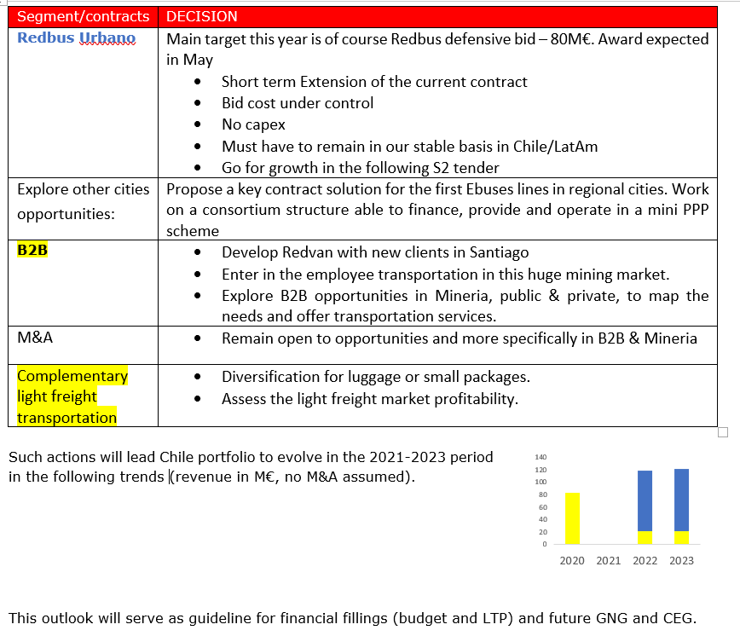
Decisions from Country strategic review must be respected in the budget and LTP to come
Decision statement to be included as the opening slide of country’s LTP presentation, with a third column « enforced » to follow up on the decisions (or comment on the gap)
Strategy associated to LTP process
Any deviance should be previously validated with Strategy Department
Workshop organized by the Strategy Department in September / October for selected geographies to review LTP strategic assumptions

Slide 12
4. Assumptions

Slide 13
Inflation (IMF April 2022 + 20 bps)

Slide 14
Financing rates / tax rates / Exchange rates
For automatic calculation of cost of financing in Tango, as we do not differentiate cost of financing by nature of debt, a blended rate has been calculated based on respective weight of indebtedness and IFRS16 debt of each country

Slide 15
Energy prices
Due to very high volatility and willingness to simplify LTP process, energy prices retained are the same as those in Budget 2023
In case of material drift by November, an adjustment will have to be taken

Slide 16
Management & Brand fees
Management fees and brand fees should be reported as disclosed in this table
This table corresponds to Budget 2023 management + brand fees inflated with France inflation rate
We remind you that no management fees should be considered on growth plan
Group MF and HQ costs should be allocated by activity as much as possible to give an economic view of net income by activity

Slide 17

5. Guidelines per category of countries

Slide 18
Procedure for small countries
Long Term Plan will be reported to financial control team
November 11th at the latest
Based on an excel sheet provided by your financial controller
With a focus on revenue, EBIT margin and major capex
LTP will be filled in in Tango by Corporate Team based on local assumptions
Final review and commitment by countries or managers in charge of new countries

Slide 19
How to manage LTP for small countries?
Who?
Filled in Tango at Paris level by Corporate team based on local assumptions
LTP stays a local commitment
What?
Focus on Revenue, EBIT, EBIT Margin and major CAPEX
Non Cash items, MF, interest and taxes will be calculated by corporate team
When?
When possible during off-peak periods
At the latest for November 11th
Where?
An excel template at local level shared with Paris
Then in Tango filled in by Corporate team

Slide 20
Procedure for big countries
Long Term Plan will be reported as previously in Tango
November 18th at the latest
In the input sheet (same process as in 2021)
Dedicated user guide available

Slide 21
6. Appendices

Slide 22
Segmentation
Urban
Ferries
Bus (urban)
Light rail
Metro
Autonomous vehicles
Airport transportation
Airside
Landside
BtoB airlines
Airport services
Suburban (only French Paris Region)
Bus/ Coach
Car Park
Interurban (ex Regional coach)
Regular lines
Schools
Charter / Occasional
BtoB regional coach
Long distance coaches
Other services
Consulting / AMO
Digital services
Call centers
Subsidized on-demand
Paratransit
Ambulance
Heavy rail
Holding
Regional heavy rail
National / International heavy rail
Rail maintenance
Note that for each activity, a generic activity is available (ie Urban - Input technical activity, Interurban - Input technical activity)
LTP could be filled in at this generic activity level without necessarily going at sub activity level

Slide 23
Transdev’s strategy starts with a clear vision of profitability levers in mobility
Portfolio management to target profitable growth
Evaluate all of Transdev activities with the same reading grid
Understand which businesses are profitable, which are not, structurally
Act on portfolio through selectivity, channelling investments only where they will generate a return
Reading grid to make sense out of Transdev’s activities, based on financial research on Transdev & competitors:
Economic growth, demand for PT
Competitive pressure, local size
Technical expertise
Scope of the value chain
Position in contract cycle

Slide 24
Portfolio management general framework
Diagnostic |  |  | Group guidelines
 | Markets | Contracts | Defensive | Offensive
High growth geographies | High growth Strong demand Need for expertise | Complex (PPP…) Capex intensive | Extend & protect margins | Partner, channel resources No limitation if in line with Group policies
Attractive mature market | Mature markets | Barriers to entry, low risk, good profitability | Yes, protect margins | Yes
Attractive mature market, low profitability | Strong competitive pressure | Uncovered risks, low margins Unfit conditions due to bad bid evaluation | Yes, protect margins | Yes if no capex No capex intensive bids
Non-attractive mature markets | Commodity transport No growth No expertise needed | Ill-designed, uncovered risks Low value added, low margins | Only if in line with action plan, provide exit plan alternative | No offensive bids

